Slide 1

Routing
Details
Unicast & Multicast
- Algorithms
By
Praloy Mondal
&
Harshadeep Bhaduri
Notes:
NOTE:
To change the image on this slide, select the picture and delete it. Then click the Pictures icon in the placeholder to insert your own image.

Slide 2
What is Routing?
Routing is the network-layer function responsible for determining the best path for packets to travel across interconnected networks.
The network layer is responsible for routing the packet from its source to the destination. A physical network is a combination of networks (LANs and WANs) and routers that connect them. This means that there is more than one route from the source to the destination.
This is done by running some routing protocols to help the routers coordinate their knowledge about the neighborhood and to come up with consistent tables to be used when a packet arrives. The routing protocols should be run before any communication occurs.

Slide 3
Delivery

Slide 4
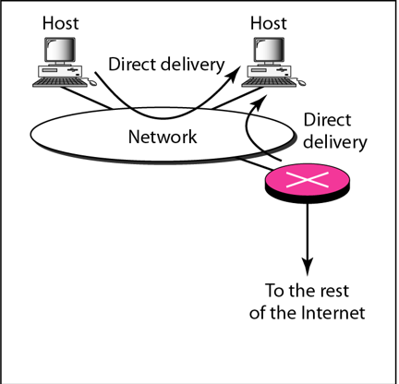
What is Delivery?
The network layer supervises the handling of the packets by the underlying physical networks. We define this handling as the delivery of a packet.
In a direct delivery, the final destination of the packet is a host connected to the same physical network as the deliverer. Direct delivery occurs when the source and destination of the packet are located on the same physical network or when the delivery is between the last router and the destination host.

Slide 5
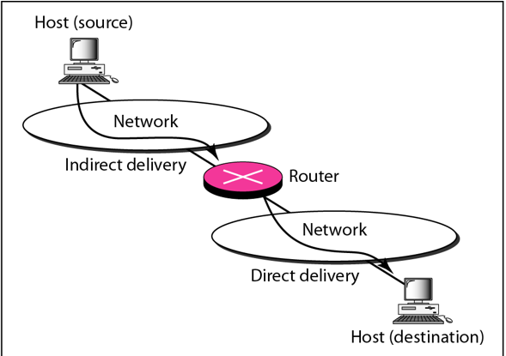
What is Delivery? (Contd.)
If the destination host is not on the same network as the deliverer, the packet is delivered indirectly. In an indirect delivery, the packet goes from router to router until it reaches the one connected to the same physical network as its final destination.

Slide 6
forwarding

Slide 7
What is Forwarding?
Forwarding can be defined as the action applied by each router when a packet arrives at one of its interfaces. Forwarding means to place the packet in its route to its destination. Forwarding requires a host or a router to have a routing table.
When a router receives a packet from one of its attached networks, it needs to forward the packet to another attached network (in unicast routing) or to some attached networks (in multicast routing).
However, this simple solution is impossible today in an internetwork such as the Internet because the number of entries needed in the routing table would make table lookups inefficient.

Slide 8
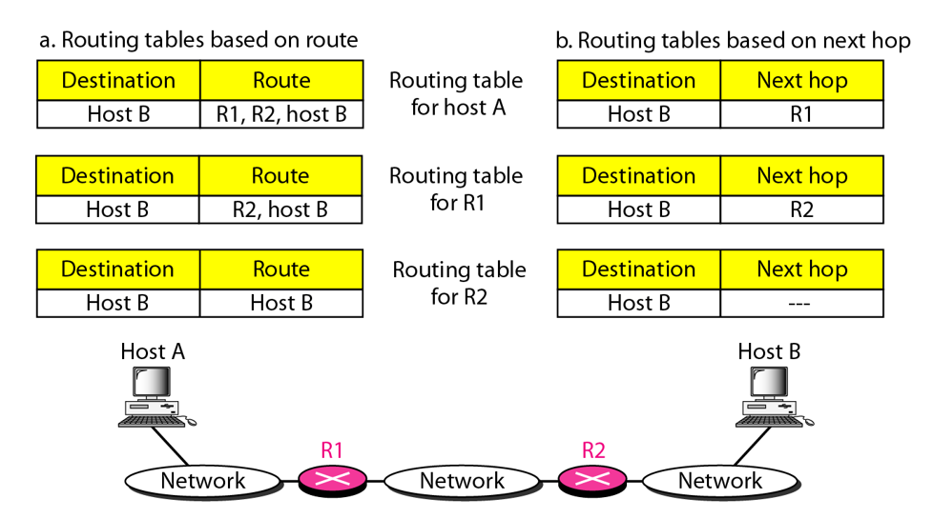
Forwarding Techniques
Route Method: The routing table holds information about the complete route.
Next-Hop: The routing table holds only the address of the next hop instead of information about the complete route.

Slide 9
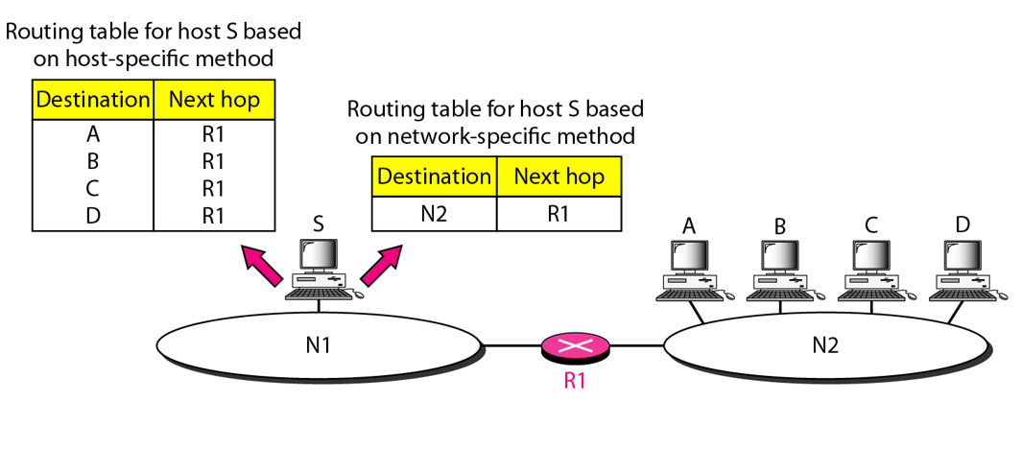
Forwarding Techniques (Contd.)
Host-Specific: Having an entry for every destination host connected to the same physical network.
Network-Specific: only one entry that defines the address of the destination network itself. In other words, we treat all hosts connected to the same network as one single entity. For example, if 1000 hosts are attached to the same network, only one entry exists in the routing table instead of 1000.

Slide 10
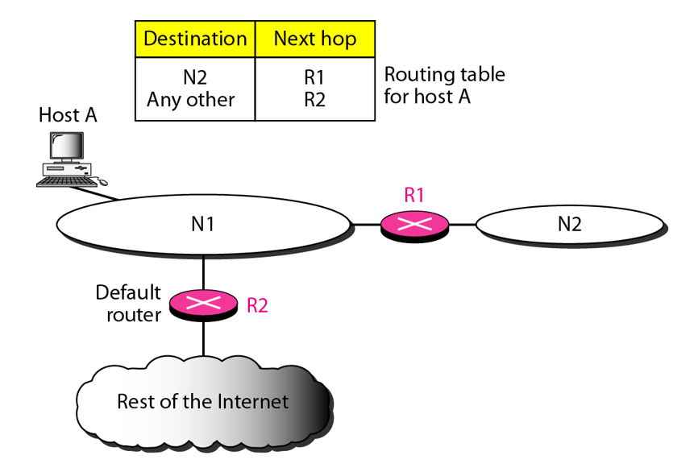
Forwarding Techniques (Contd.)
Default: Let’s assume, host A is connected to a network with two routers. Router Rl routes the packets to hosts connected to network N2. However, for the rest of the Internet, router R2 is used. So instead of listing all networks in the entire Internet, host A can just have one entry called the default (normally defined as network address 0.0.0.0).

Slide 11
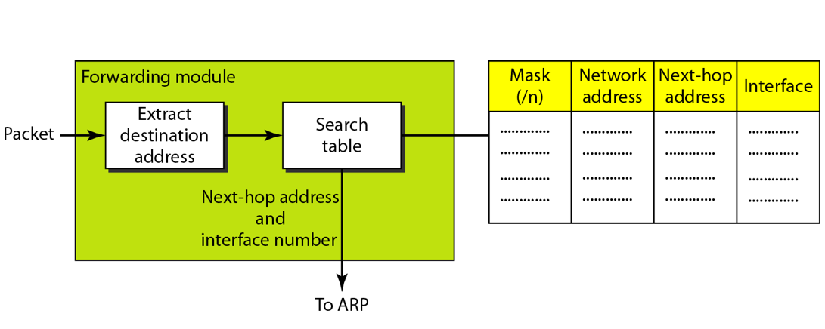
Forwarding Process
We assume that hosts and routers use classless addressing because classful addressing can be treated as a special case of classless addressing.
The routing table needs to have one row of information for each block involved. The table needs to be searched based on the network address (first address in the block).
The destination address in the packet gives no clue about the network address. To solve the problem, we need to include the mask (/n) in the table.

Slide 12
Forwarding Process (Contd.)
Example: Shows how router R1 processes an incoming packet destined to 180.70.65.140 using its routing table and longest-prefix matching.
Apply the first mask (likely /26) to the destination:
Compute bitwise AND: 180.70.65.140 & mask1 → result Does it match the corresponding network address in row 1? No.
Apply the second mask (likely /25):180.70.65.140 & mask2 → 180.70.65.128, which matches the network address in row 2.
Once a match is found: The router uses the next-hop address and interface (say, m0) from that entry to forward the packet.
These are passed to ARP (Address Resolution Protocol) for delivery.

Slide 13
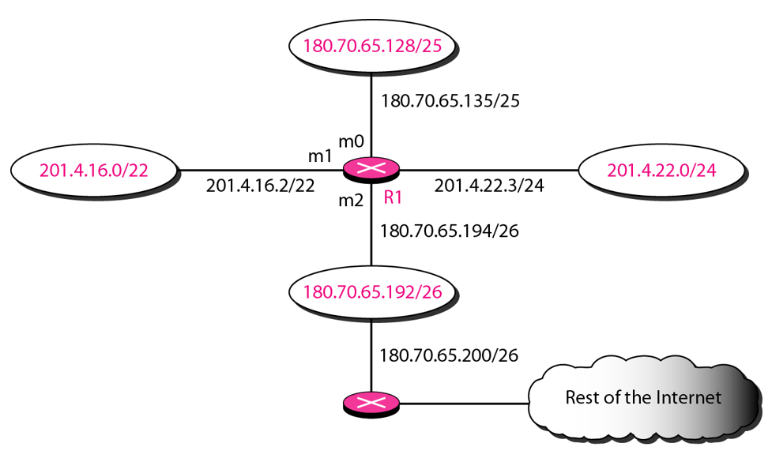
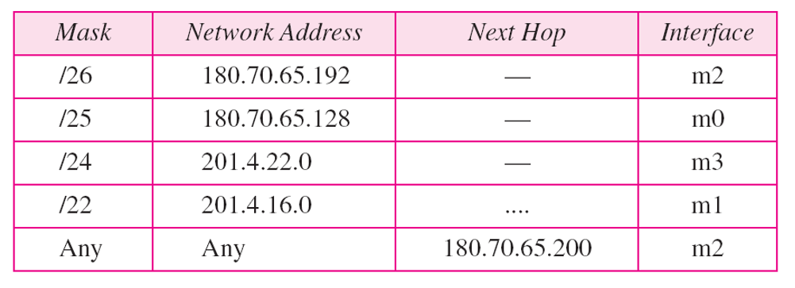
Forwarding Process (Contd.)

Slide 14
Address Aggregation

Slide 15
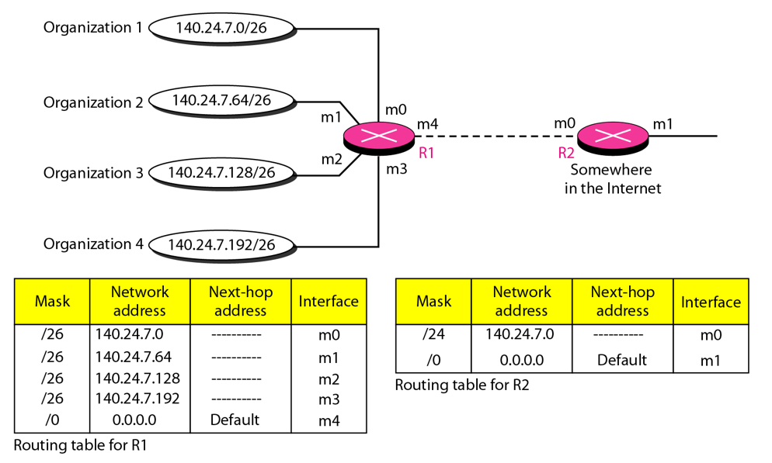
Address Aggregation
When we use classless addressing, it is likely that the number of routing table entries will increase. This is so because the intent of classless addressing is to divide up the whole address space into manageable blocks. Therefore, time to search the table will increase. Hence why, the idea of address aggregation was introduced.
Router R1 is connected to networks of four organizations that each use 64 addresses. Router R2 is somewhere far from R1. Router R1 has a longer routing table because each packet must be correctly routed to the appropriate organization.
Router R2, on the otherhand, can have a very small routing table. For R2, any packet with destination 140.24.7.0 to 140.24.7.255 is sent out from interface mO regardless of the organization number.
Note that although the idea of address aggregation is similar to the idea of subnetting, we do not have a common site here.

Slide 16
Why It’s Needed
Without aggregation Routers would need to keep a separate entry for every small subnet.
This makes routing tables huge and lookup slower.
With aggregation multiple entries can be merged into one, reducing table size.

Slide 17
Longest Mask Matching aka. Longest Prefix Matching
What happens if one of the organizations in previous figure is not geographically close to the other three? For example, if organization 4 cannot be connected to router R1 for some reason, can we still use the idea of address aggregation and still assign block 140.24.7.192/26 to organization 4?

Slide 18
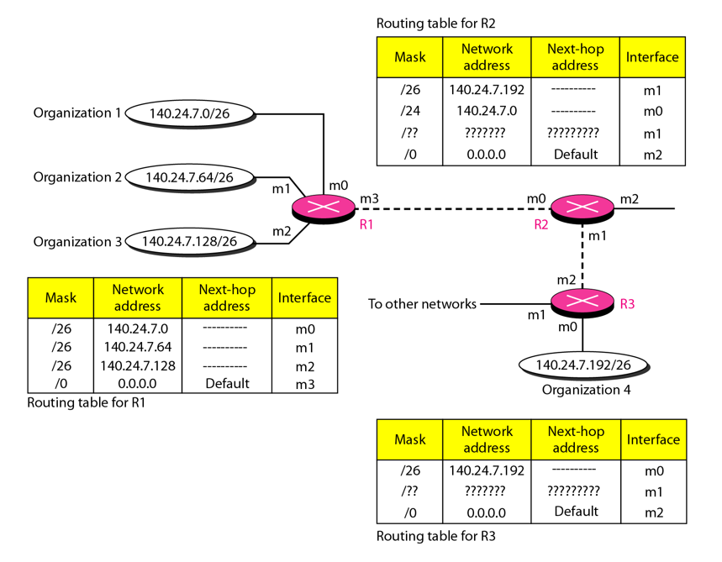
Longest Mask Matching
Answer is Yes.
This principle states that the routing table is sorted from the longest mask to the shortest mask. In other words, if there are three masks /27, /26, and /24, the mask /27 must be the first entry and /24 must be last.
Suppose a packet arrives for organization 4 with destination address 140.24.7.200.The first mask at router R2 is applied, which gives the network address 140.24.7.192. The packet is routed correctly from interface m1 and reaches organization 4.
If, however, the routing table was not stored with the longest prefix first, applying the /24 mask would result in the incorrect routing of the packet to router R1.

Slide 19
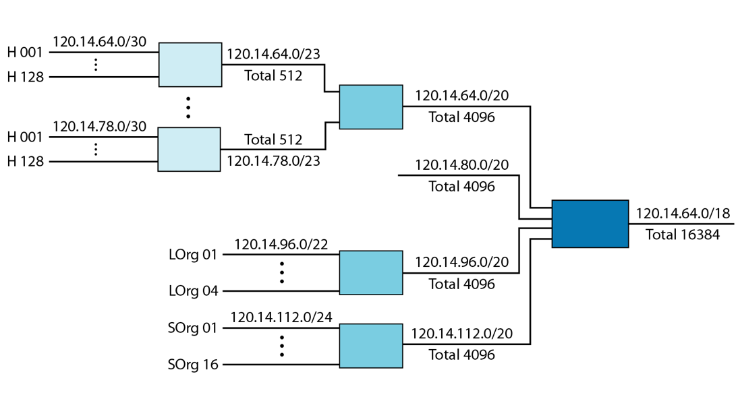
Hierarchical Routing
All customers of the local ISP are defined as a.b.c.d/n to the rest of the Internet. Every packet destined for one of the addresses in this large block is routed to the local ISP.
There is only one entry in every router in the world for all these customers. They all belong to the same group. Of course, inside the local ISP, the router must recognize the subblocks and route the packet to the destined customer.
If one of the customers is a large organization, it also can create another level of hierarchy by subnetting and dividing its subblock into smaller subblocks (or sub-subblocks).
In classless routing, the levels of hierarchy are unlimited so long as we follow the rules of classless addressing.

Slide 20
Geographical Routing
To decrease the size of the routing table even further, we need to extend hierarchical routing to include geographical routing. We must divide the entire address space into a few large blocks.
We assign a block to North America, a block to Europe, a block to Asia, a block to Africa, and so on.
The routers of ISPs outside Europe will have only one entry for packets to Europe in their routing tables.
The routers of ISPs outside North America will have only one entry for packets to North America in their routing tables. And so on.

Slide 21
Router

Slide 22
What is a Router?
A router, in fact, is a switch that creates a connection between an input port and an output port (or a set of output ports).
Only packet switching is used at the network layer because the unit of data at this layer is a packet.

Slide 23
Routing Tables
A host or a router has a routing table with an entry for each destination, or a combination of destinations, to route IP packets.
Static Routing Table: A static routing table contains information entered manually. The administrator enters the route for each destination into the table. When a table is created, it cannot update automatically when there is a change in the Internet. The table must be manually altered by the administrator.
A static routing table can be used in a small internet that does not change very often, or in an experimental internet for troubleshooting.
Dynamic Routing Table: A dynamic routing table is updated periodically by using one of the dynamic routing protocols such as RIP, OSPF, or BGP. Whenever there is a change in the Internet, such as a shutdown of a router or breaking of a link, the dynamic routing protocols update all the tables in the routers (and eventually in the host) automatically.

Slide 24
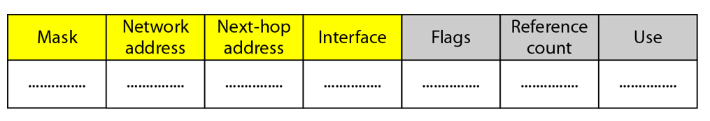
Routing Tables (Contd.)
Format: A routing table for classless addressing has a minimum of four columns. However, some of today's routers have even more columns. Not all columns can be found in all routers.
Mask: This field defines the mask applied for the entry.
Network address: This field defines the network address to which the packet is finally delivered. In the case of host-specific routing, this field defines the address of the destination host.
Next-hop address: This field defines the address of the next-hop router to which the packet is delivered.
Interface: This field shows the name of the interface.
Flags. This field defines up to five flags. Flags are on/off switches that signify either presence or absence. The five flags are U (up), G (gateway), H (host-specific), D (added by redirection), and M (modified by redirection).
Reference count: This field gives the number of users of this route at the moment.
Use: This field shows the number of packets transmitted through this router for the corresponding destination

Slide 25
Routing Tables (Contd.)
Flags(Contd.): U (up): The U flag indicates the router is up and running. If this flag is not present, it means that the router is down. The packet cannot be forwarded and is discarded.
G (gateway): The G flag means that the destination is in another network. The packet is delivered to the next-hop router for delivery (indirect delivery). When this flag is missing; it means the destination is in this network (direct delivery).
H (host-specific): The H flag indicates that the entry in the network address field is a host-specific address. When it is missing, it means that the address is only the network address of the destination.
D (added by redirection): The D flag indicates that routing information for this destination has been added to the host routing table by a redirection message from ICMP.
M (modified by redirection). The M flag indicates that the routing information for this destination has been modified by a redirection message from ICMP.

Slide 26
Unicast Routing

Slide 27
General Idea
The goal of the network layer is to deliver a datagram from its source to its destination or destinations. If a datagram is destined for only one destination (one-to-one delivery), we have unicast routing.
In unicast routing, a packet is routed, hop by hop, from its source to its destination by the help of forwarding tables.
Only the routers that glue together the networks in the internet need forwarding tables.
Routing a packet from its source to its destination means routing the packet from a source router (the default router of the source host) to a destination router (the router connected to the destination network).

Slide 28
Optimization
When a router receives a packet, to which network should it pass the packet?
The decision is based on optimization: Which of the available pathways is the optimum pathway?
One approach is to assign a cost for passing through a network. We call this cost a metric.
RIP (Routing Information Protocol): Treat all networks as equals. The cost of passing through a network is the same; it is one hop count. So, if a packet passes through 10 networks to reach the destination, the total cost is 10 hop counts.
OSFP (Open Shortest Path First): allow the administrator to assign a cost for passing through a network based on the type of service required. A route through a network can have different costs (metrics). For example, if maximum throughput is the desired type of service, a satellite link has a lower metric than a fiber-optic line. On the other hand, if minimum delay is the desired type of service, a fiber-optic line has a lower metric than a satellite link. OSPF protocol allows each router to have several routing tables based on the required type of service.

Slide 29
Optimization
BGP(Border Gateway Protocol): The criterion is the policy, which can be set by the administrator. The policy defines what paths should be chosen.

Slide 30
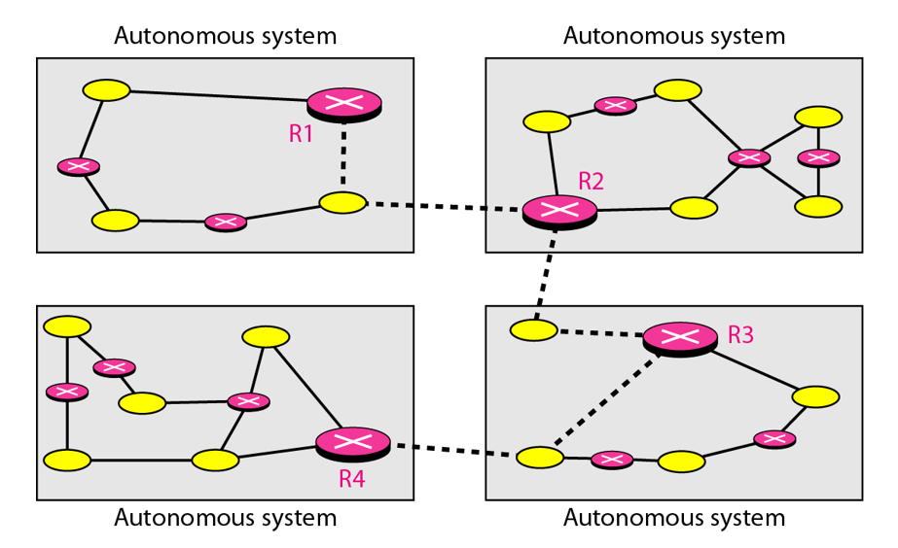
Intradomain and Interdomain Routing
Today, an internet can be so large that one routing protocol cannot handle the task of updating the routing tables of all routers.
For this reason, an internet is divided into autonomous systems. An autonomous system (AS) is a group of networks and routers under the authority of a single administration.
Routing inside an autonomous system is referred to as intradomain routing.
Routing between autonomous systems is referred to as interdomain routing.
Each autonomous system can choose one or more intradomain routing protocols to handle routing inside the autonomous system. However, only one interdomain routing protocol handles routing between autonomous systems

Slide 31
Distance vector routing

Slide 32
Least-Cost Trees
If there are N routers in an internet, there are (N − 1) least-cost paths from each router to any other router. This means we need N × (N − 1) least-cost paths for the whole internet. If we have only 10 routers in an internet, we need 90 least-cost paths.
A better way to see all of these paths is to combine them in a least-cost tree. A least-cost tree is a tree with the source router as the root that spans the whole graph (visits all other nodes) and in which the path between the root and any other node is the shortest.

Slide 33
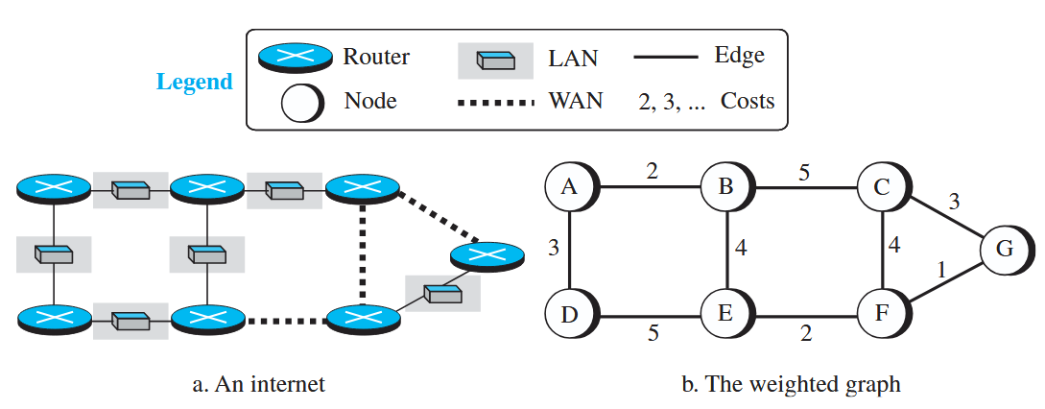
Least-Cost Routing
To find the best route, an internet can be modeled as a weighted graph. If there is no edge between the nodes, the cost is infinity.
When an internet is modeled as a weighted graph, one of the ways to interpret the best route from the source router to the destination router is to find the least cost between the two.

Slide 34
Routing Algorithm: Distance-Vector Routing

Slide 35
Introduction
In distance-vector routing, the first thing each node creates is its own least-cost tree with the rudimentary information it has about its immediate neighbors. The incomplete trees are exchanged between immediate neighbors to make the trees more and more complete and to represent the whole internet.
We can say that in distance-vector routing, a router continuously tells all of its neighbors what it knows about the whole internet (although the knowledge can be incomplete).
The heart of distance-vector routing is the famous Bellman-Ford equation. This equation is used to find the least cost (shortest distance) between a source node, x, and a destination node, y, through some intermediary nodes (a, b, c, . . .) when the costs between the source and the intermediary nodes and the least costs between the intermediary nodes and the destination are given.
which can be written as,
Dij: Distance between i and j
cij: Cost between i and j

Slide 36
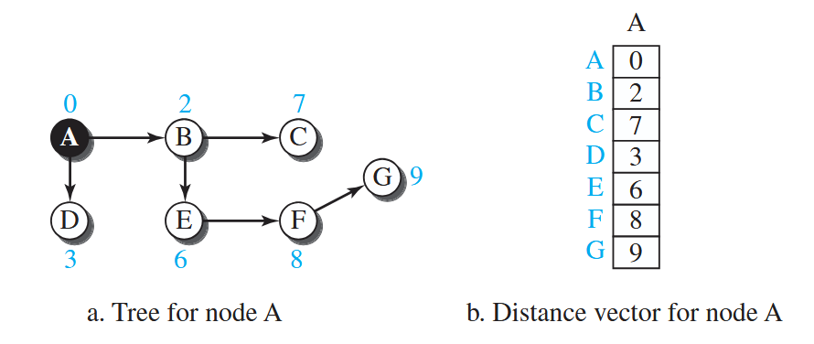
Distance Vector
A least-cost tree is a combination of least-cost paths from the root of the tree to all destinations. These paths are graphically glued together to form the tree. Distance-vector routing unglues these paths and creates a distance vector, a one-dimensional array to represent the tree.
Note that the name of the distance vector defines the root, the indexes define the destinations, and the value of each cell defines the least cost from the root to the destination.

Slide 37
Distance Vector (Contd.)
Each node in an internet, when it is booted, creates a very rudimentary distance vector with the minimum information the node can obtain from its neighborhood. The node sends some greeting messages out of its interfaces and discovers the identity of the immediate neighbors and the distance between itself and each neighbor.
It then makes a simple distance vector by inserting the discovered distances in the corresponding cells and leaves the value of other cells as infinity.

Slide 38
How It Works
Initialization: A router knows the distance to itself = 0.
Distance to directly connected networks = 1.
Distance to others = ∞ (unknown).
Sharing: Periodically (say every 30 sec in RIP), each router sends its distance vector to neighbors only or it can be change triggered.
Updating (Bellman–Ford Algorithm): When a router gets a neighbor’s table, it updates its own: New Distance = (Neighbor’s Distance to Destination + Cost to reach Neighbor).
If this new path is shorter, update distance and next hop. Convergence After several rounds of exchanges, all routers learn the shortest distances. The network converges when tables stop changing

Slide 39
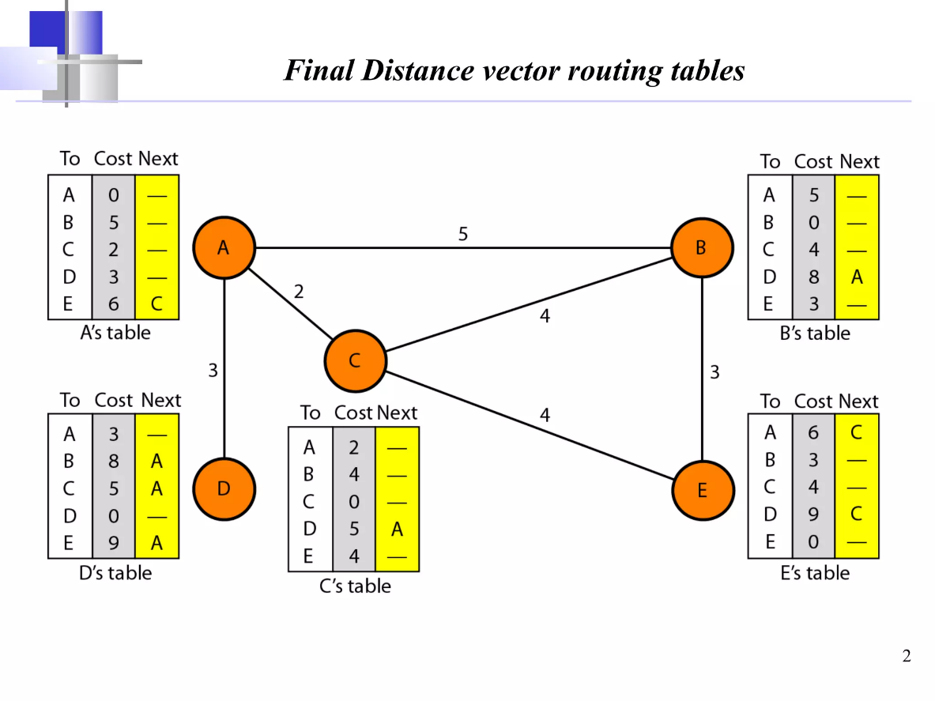
Distance Vector (Contd.)
These rudimentary vectors cannot help the internet to effectively forward a packet. For example, node A thinks that it is not connected to node G because the corresponding cell shows the least cost of infinity.
To improve these vectors, the nodes in the internet need to help each other by exchanging information. After each node has created its vector, it sends a copy of the vector to all its immediate neighbors.
After a node receives a distance vector from a neighbor, it updates its distance vector using the Bellman-Ford equation.

Slide 40
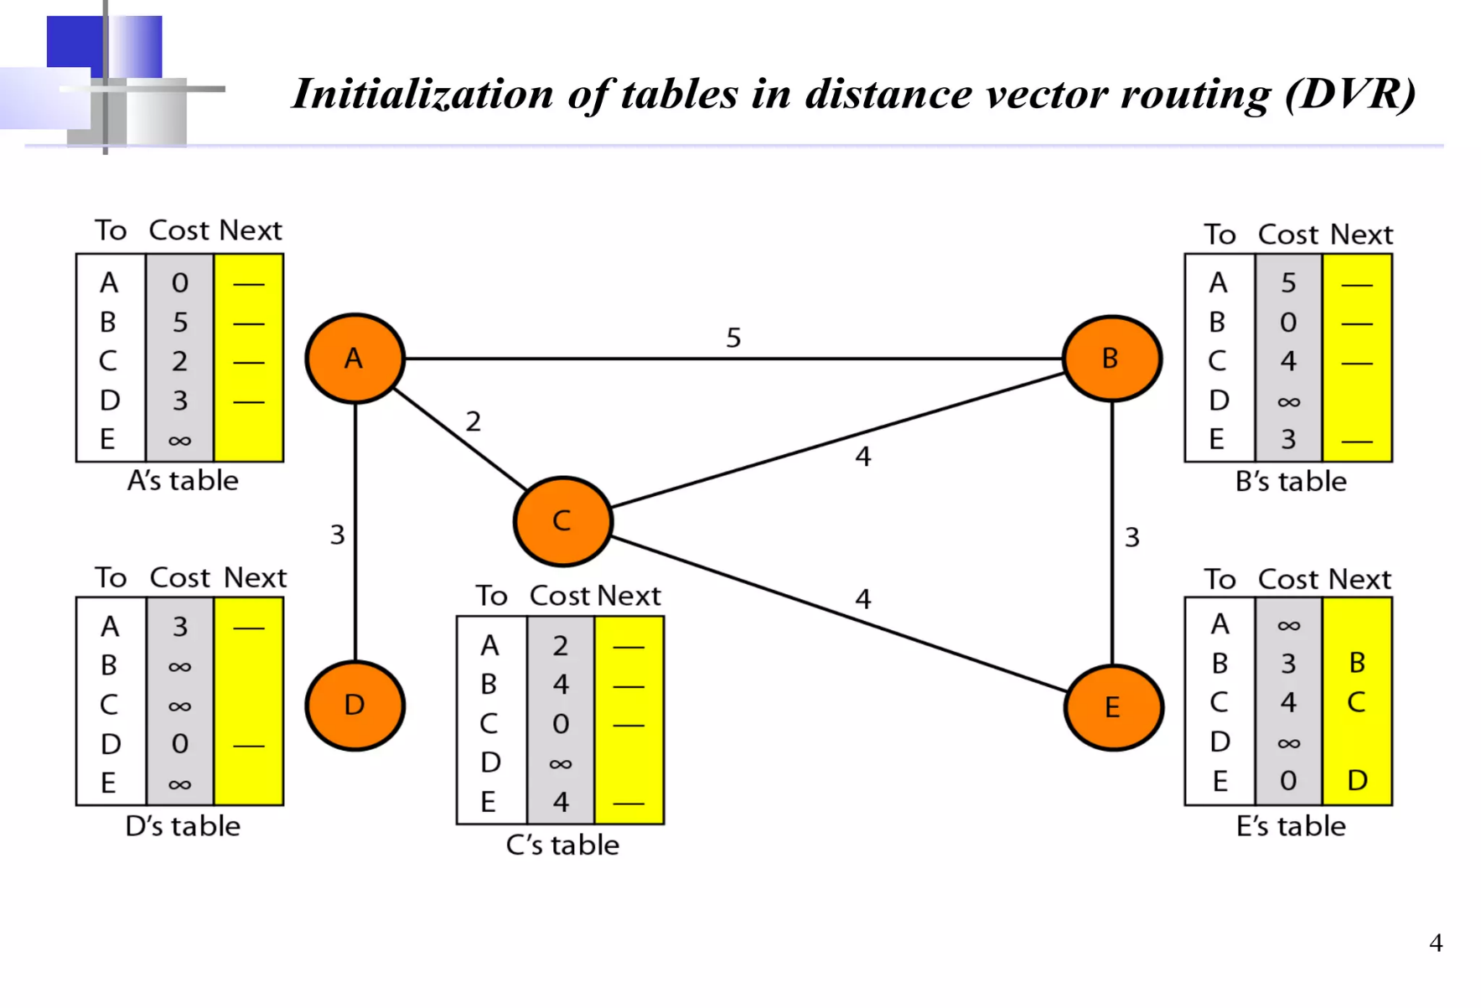
Distance Vector (Contd.)

Slide 41
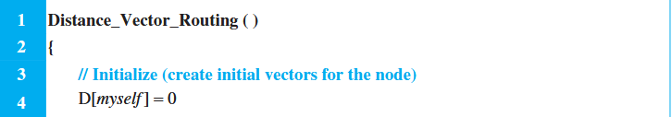
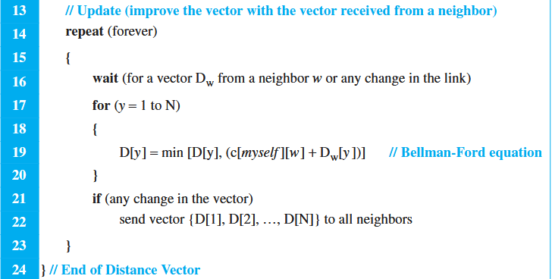
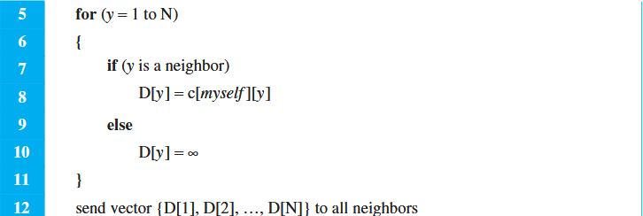
Distance Vector (Contd.)

Slide 42
Problem With Distance Vector
A problem with distance-vector routing is that any decrease in cost (good news) propagates quickly, but any increase in cost (bad news) will propagate slowly. The problem is referred to as count to infinity. It sometimes takes several updates before the cost for a broken link is recorded as infinity by all routers.
One example of count to infinity is the two-node loop problem.

Slide 43
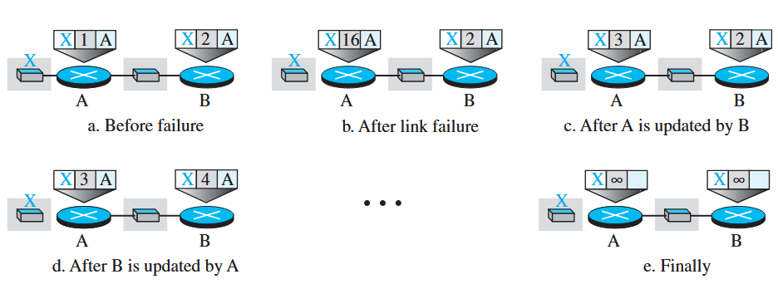
Problem With Distance Vector
Two Node Problem:
At the beginning, both nodes A and B know how to reach node X. But suddenly, the link between A and X fails. Node A changes its table. If A can send its table to B immediately, everything is fine. However, the system becomes unstable if B sends its forwarding table to A before receiving A’s forwarding table.
Node A receives the update and, assuming that B has found a way to reach X, immediately updates its forwarding table. Now A sends its new update to B. Now B thinks that something has been changed around A and updates its forwarding table. The cost of reaching X increases gradually until it reaches infinity. At this moment, both A and B know that X cannot be reached.

Slide 44
Two Node Problem (Contd.) and Solution
However, during this time the system is not stable. Node A thinks that the route to X is via B; node B thinks that the route to X is via A. If A receives a packet destined for X, the packet goes to B and then comes back to A. Similarly, if B receives a packet destined for X, it goes to A and comes back to B. Packets bounce between A and B, creating a two-node loop problem. A few solutions have been proposed for instability of this kind.
Split Horizon Solution: In this strategy, instead of flooding the table through each interface, each node sends only part of its table through each interface. If, according to its table, node B thinks that the optimum route to reach X is via A, it does not need to advertise this piece of information to A; the information has come from A (A already knows). The system becomes stable after the first update: both node A and node B know that X is not reachable.
Poison Reverse: Using the split-horizon strategy has one drawback. Normally, the corresponding protocol uses a timer, and if there is no news about a route, the node deletes the route from its table. When node B in the previous scenario eliminates the route to X from its advertisement to A, node A cannot guess whether this is due to the split-horizon strategy (the source of information was A) or because B has not received any news about X recently. In the poison reverse strategy B can still advertise the value for X
If the instability is between three nodes, stability cannot be guaranteed.

Slide 45
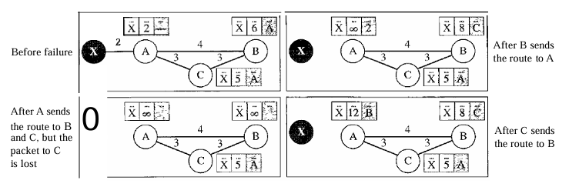
3 node instability problem
We have no solution for this problem

Slide 46
RIP
The Routing Information Protocol (RIP) is an intradomain routing protocol used inside an autonomous system. It is a very simple protocol based on distance vector routing. RIP implements distance vector routing directly with some considerations:
1. In an autonomous system, we are dealing with routers and networks (links). The routers have routing tables; networks do not.
2. The destination in a routing table is a network, which means the first column defines a network address.
3. The metric used by RIP is very simple; the distance is defined as the number of links (networks) to reach the destination. For this reason, the metric in RIP is called a hop count.
4. Infinity is defined as 16, which means that any route in an autonomous system using RIP cannot have more than 15 hops.
5. The next-node column defines the address of the router to which the packet is to be sent to reach its destination.

Slide 47
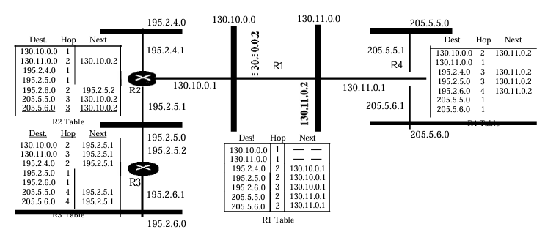
Lets understand RIP
An autonomous system with seven networks and four routers. The table of each router is also shown. Let us look at the routing table for R1. The table has seven entries to show how to reach each network in the autonomous system. Router R1 is directly connected to networks 130.10.0.0 and 130.11.0.0, which means that there are no next-hop entries for these two networks. To send a packet to one of the three networks at the far left, router R1needs to deliver the packet to R2. The next-node entry for these three networks is the interface of router R2 with IP address 130.10.0.1. To send a packet to the two networks at the far right, router R1needs to send the packet to the interface of router R4 with IP address 130.11.0.1.

Slide 48
Routing Algorithm: Link state Routing

Slide 49
Introduction
This method uses the term link-state to define the characteristic of a link (an edge) that represents a network in the internet. In this algorithm the cost associated with an edge defines the state of the link.
Links with lower costs are preferred to links with higher costs; if the cost of a link is infinity, it means that the link does not exist or has been broken.

Slide 50
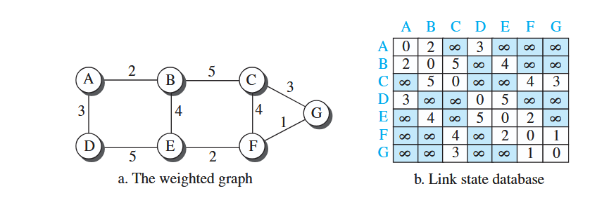
Link State Database (LSDB)
To create a least-cost tree with this method, each node needs to have a complete map of the network, which means it needs to know the state of each link. The collection of states for all links is called the link-state database (LSDB).
There is only one LSDB for the whole internet; each node needs to have a duplicate of it to be able to create the least-cost tree.

Slide 51
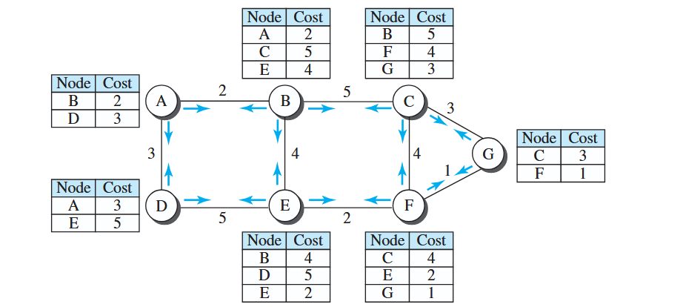
LSDB
LSDB is created using a process known as flooding. Each node can send some greeting messages to all its immediate neighbors (those nodes to which it is connected directly) to collect two pieces of information for each neighboring node: the identity of the node and the cost of the link.
The combination of these two pieces of information is called the LS packet (LSP). The LSP is sent out of each interface. When a node receives an LSP from one of its interfaces, it compares the LSP with the copy it may already have. If the newly arrived LSP is older than the one it has (found by checking the sequence number), it discards the LSP. If it is newer or the first one received, the node discards the old LSP (if there is one) and keeps the received one.
It then sends a copy of it out of each interface except the one from which the packet arrived.

Slide 52
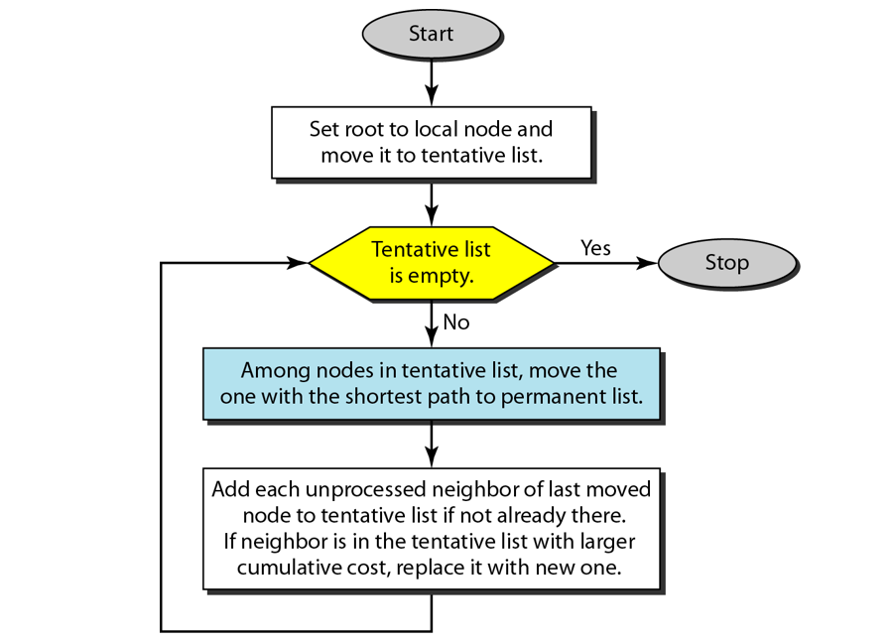
Formation of Least Cost Trees
Dijkstra’s Algorithm:

Slide 53
OSPF
The Open Shortest Path First or OSPF protocol is an intradomain routing protocol based on link state routing. Its domain is also an autonomous system. Areas To handle routing efficiently and in a timely manner, OSPF divides an autonomous system into areas.
An area is a collection of networks, hosts, and routers all contained within an autonomous system. An autonomous system can be divided into many different areas. All networks inside an area must be connected. Routers inside an area flood the area with routing information.
At the border of an area, special routers called area border routers summarize the information about the area and send it to other areas. Among the areas inside an autonomous system is a special area called the backbone; all the areas inside an autonomous system must be connected to the backbone. In other words, the backbone serves as a primary area and the other areas as secondary areas. This does not mean that the routers within areas cannot be connected to each other, however.
The routers inside the backbone are called the backbone routers. Note that a backbone router can also be an area border router. If, because of some problem, the connectivity between a backbone and an area is broken, a virtual link between routers must be created by an administrator to allow continuity of the functions of the backbone as the primary area.

Slide 54
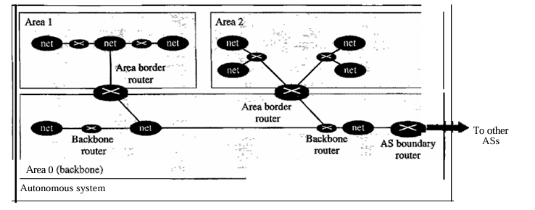
OSPF

Slide 55
Routing Algorithm: Path vector Routing

Slide 56
Introduction
Both link-state and distance-vector routing are based on the least-cost goal. However, there are instances where this goal is not the priority. For example, assume that there are some routers in the internet that a sender wants to prevent its packets from going through.
Least-cost routing does not prevent a packet from passing through an area when that area is in the least-cost path.
When the goal of routing is merely reachability: to allow the packet to reach its destination more efficiently without assigning costs to the route.

Slide 57
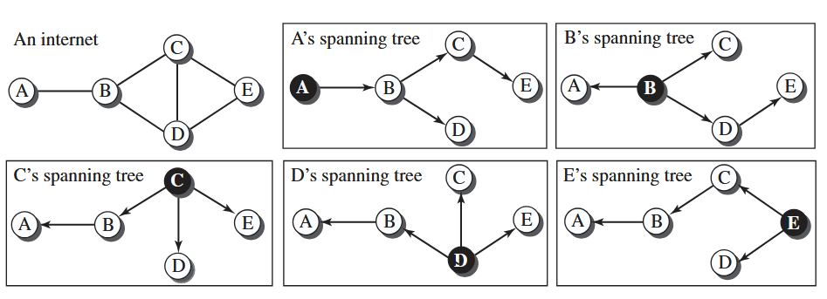
Spanning Tree
In path-vector routing, the path from a source to all destinations is also determined by the best spanning tree.
Best Spanning Tree is the tree determined by the source when it imposes its own policy. If there is more than one route to a destination, the source can choose the route that meets its policy best.
One of the common policies uses the minimum number of nodes to be visited (something similar to least-cost). Another common policy is to avoid some nodes as the middle node in a route.

Slide 58
Creation of Spanning Tree
When a node is booted, it creates a path vector based on the information it can obtain about its immediate neighbor. A node sends greeting messages to its immediate neighbors to collect these pieces of information.
Each node, after the creation of the initial path vector, sends it to all its immediate neighbors. Each node, when it receives a path vector from a neighbor, updates its path vector using an equation similar to the Bellman-Ford, but applying its own policy instead of looking for the least cost.

Slide 59
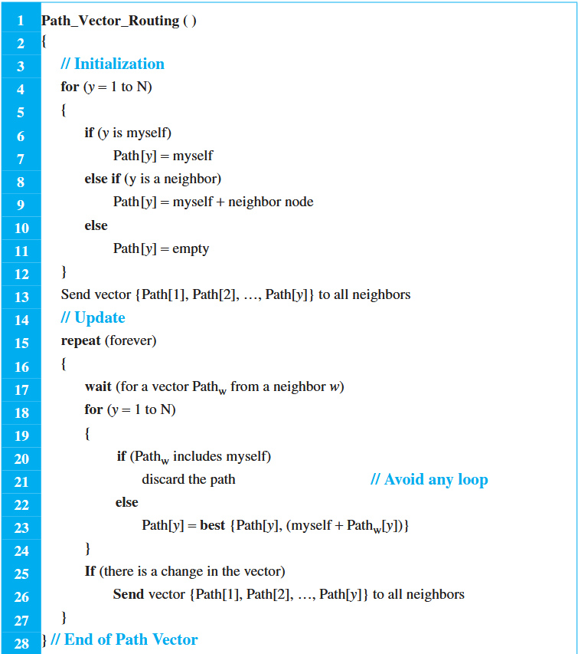
Algorithm for Path Vector Routing

Slide 60
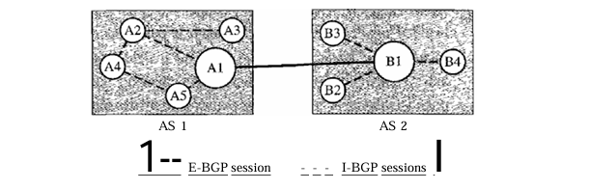
BGP
Border Gateway Protocol (BGP) is an interdomain routing protocol using path vector routing. It first appeared in 1989 and has gone through four versions. Types of Autonomous Systems As we said before, the Internet is divided into hierarchical domains called autonomous systems.
For example, a large corporation that manages its own network and has full control over it is an autonomous system. A local ISP that provides services to local customers is an autonomous system. We can divide autonomous systems into three categories: stub, multihomed, and transit.
Internal and external BGP sessions

Slide 61
Multicast Routing

Slide 62
Introduction
In multicast communication, there is one source and a group of destinations. The relationship is one-to-many. In this type of communication, the source address is a unicast address, but the destination address is a group address.
We need to distinguish between multicasting and multiple unicasting. Multicasting starts with one single packet from the source that is duplicated by the routers. The destination address in each packet is the same for all duplicates. In multiple unicasting, several packets start from the source. If there are five destinations, for example, the source sends five packets, each with a different unicast destination address.

Slide 63
Emulation
Why do we have separate mechanism for multicasting and unicasting, when we can emulate the former using the later?

Slide 64
Emulation
Multicasting is more efficient than multiple unicasting: multicasting requires less bandwidth than does multiple unicasting. In multiple unicasting, some of the links must handle several copies.
In multicasting, there is no delay because only one packet is created by the source. In multiple unicasting, If there are 1000 destinations, the delay between the first and the last packet may be unacceptable.

Slide 65
Application for Multicasting
Most of the large databases today are distributed. A user's request is multicast to all the database locations, and the location that has the information responds.
If the nature of the information is the same for each client, it can be multicast. For example, a software update can be sent to all purchasers of a particular software package.
In a similar manner news can be easily disseminated through multicasting. One single message can be sent to those interested in a particular topic.
And more…..

Slide 66
Optimal Routing: Shortest path tree

Slide 67
Shortest Path Tree
The process of optimal interdomain routing eventually results in the finding of the shortest path tree. The root of the tree is the source, and the leaves are the potential destinations.
Short Recap:
In unicast routing, when a router receives a packet to forward, it needs to find the shortest path to the destination of the packet. The router consults its routing table for that particular destination.
The next-hop entry corresponding to the destination is the start of the shortest path. The router knows the shortest path for each destination, which means that the router has a shortest path tree to optimally reach all destinations.

Slide 68
Shortest Path Tree (Contd.)
Forwarding of a single multicast packet to members of a group requires a shortest path tree. If we have n groups, we may need n shortest path trees.
Two approaches have been used to solve the problem: source-based trees and group-shared trees.

Slide 69
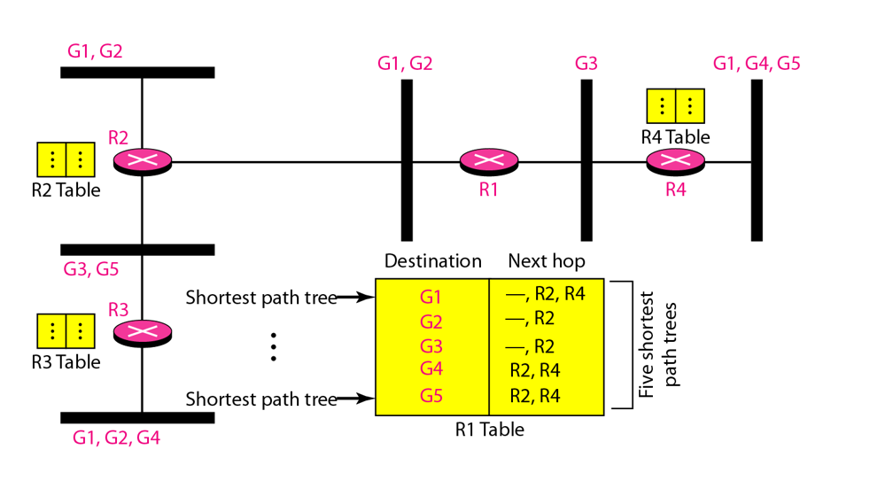
Source-Based Tree
In the source-based tree approach, each router needs to have one shortest path tree for each group. The shortest path tree for a group defines the next hop for each network that has loyal member(s) for that group.
We assume that we have only five groups in the domain: G1 G2, G3, G4, and G5. At the moment G1 has loyal members in four networks, G2 in three, G3 in two, G4 in two, and G5 in two.
There is one shortest path tree for each group; therefore, there are five shortest path trees for five groups. If router R1 receives a packet with destination address G1 it needs to send a copy of the packet to the attached network, a copy to router R2, and a copy to router R4 so that all members of G1 can receive a copy.
In this approach, if the number of groups is m, each router needs to have m shortest path trees, one for each group

Slide 70
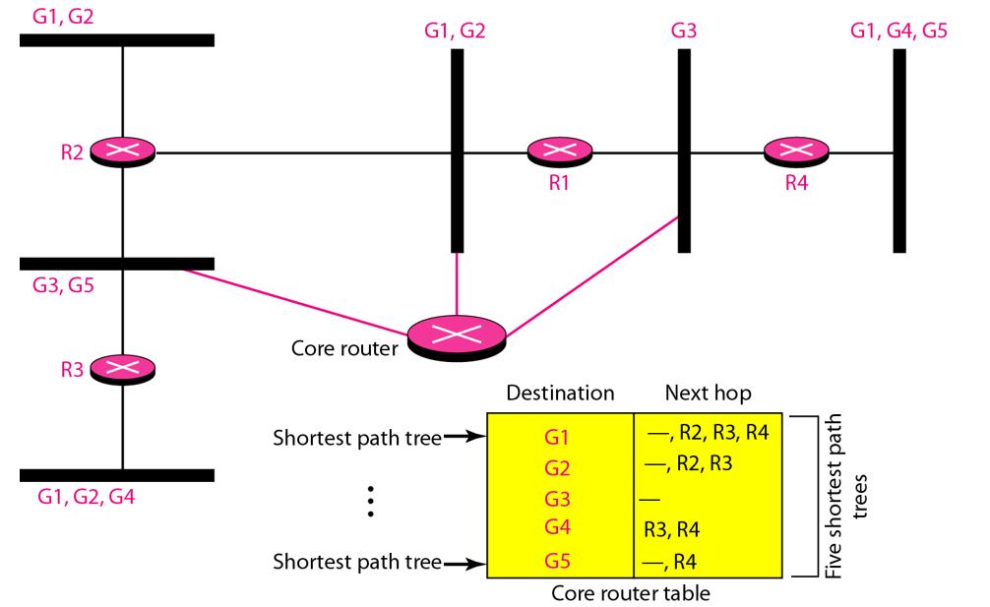
Group-Based Tree
In the group-shared tree approach, instead of each router having m shortest path trees, only one designated router, called the center core, or rendezvous router, takes the responsibility of distributing multicast traffic.
The core has m shortest path trees in its routing table. The rest of the routers in the domain have none. If a router receives a multicast packet, it encapsulates the packet in a unicast packet and sends it to the core router.
The core router removes the multicast packet from its capsule, and consults its routing table to route the packet.

Slide 71
Routing protocol

Slide 72
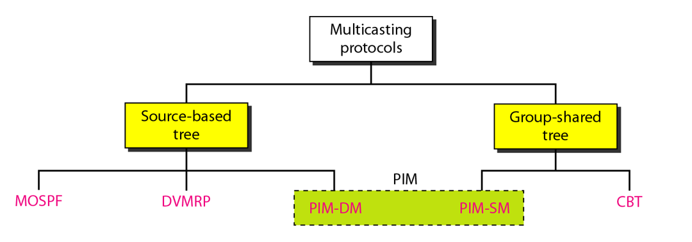
Routing Protocols

Slide 73
Multicast Link State Routing: MOSPF

Slide 74
Multicast Link State Routing: MOSPF
The routing table is a translation of the shortest path tree. Multicast link state routing is a direct extension of unicast routing and uses a source-based tree approach.
Recall that in unicast routing, each node needs to advertise the state of its links. For multicast routing, a node needs to revise the interpretation of state.
A node advertises every group which has any loyal member on the link. Here the meaning of state is “what groups are active on this link.” The information about the group comes from IGMP.
When a router receives all these LSPs, it creates n (n is the number of groups) topologies, from which n shortest path trees are made by using Dijkstra's algorithm. So each router has a routing table that represents as many shortest path trees as there are groups.
The only problem with this protocol is the time and space needed to create and save the many shortest path trees. The solution is to create the trees only when needed.

Slide 75
Multicast Distance Vector: DVMRP

Slide 76
Multicast Distance Vector: DVMRP
Multicast Distance Vector Routing Unicast distance vector routing is very simple; extending it to support multicast routing is complicated. Multicast routing does not allow a router to send its routing table to its neighbors. The idea is to create a table from scratch by using the information from the unicast distance vector tables.
Multicast distance vector routing uses source-based trees, but the router never actually makes a routing table. When a router receives a multicast packet, it forwards the packet as though it is consulting a routing table. We can say that the shortest path tree is evanescent. After its use (after a packet is forwarded) the table is destroyed.
DVMRP is accomplished using several strategies. The multicast distance vector algorithm uses a process based on four decision-making strategies. Each strategy is built on its predecessor. We explain them one by one and see how each strategy can improve the shortcomings of the previous one.

Slide 77
Flooding
Flooding is the first strategy that comes to mind. A router receives a packet and, without even looking at the destination group address, sends it out from every interlace except the one from which it was received. Flooding accom plishes the first goal of multicasting: every network with active members receives the packet. However, so will networks without active members. This is a broadcast, not a multicast. There is another problem: it creates loops. A packet that has left the router may come back again from another interlace or the same interlace and be forwarded again.

Slide 78
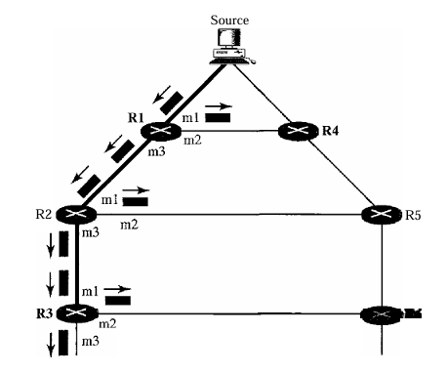
Reverse Path Forwarding (RPF)
RPF is a modified flooding strategy. To prevent loops, only one copy is forwarded; the other copies are dropped. In RPF, a router for wards only the copy that has traveled the shortest path from the source to the router. To find this copy, RPF uses the unicast routing table. The router receives a packet and extracts the source address (a unicast address). It consults its unicast routing table as though it wants to send a packet to the source address. The routing table tells the router the next hop. If the multicast packet has just come from the hop defined in the table, the packet has traveled the shortest path from the source to the router because the shortest path is reciprocal in unicast distance vector routing protocols. If the path from A to B is the shortest, then it is also the shortest from B to A. The router for wards the packet if it has traveled from the shortest path; it discards it otherwise.

Slide 79
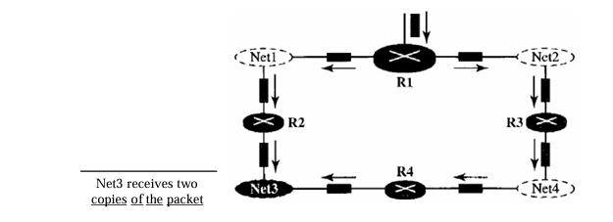
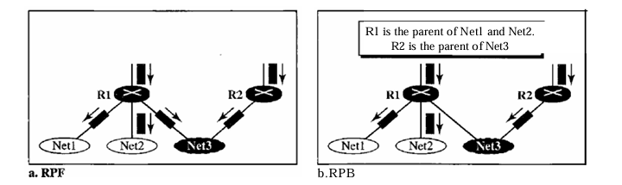
Reverse Path Broadcasting (RPB)
To eliminate duplication, we must define only one parent router for each network. We must have this restriction: A network can receive a multicast packet from a particular source only through a designated parent router.
RPF vs RPB

Slide 80
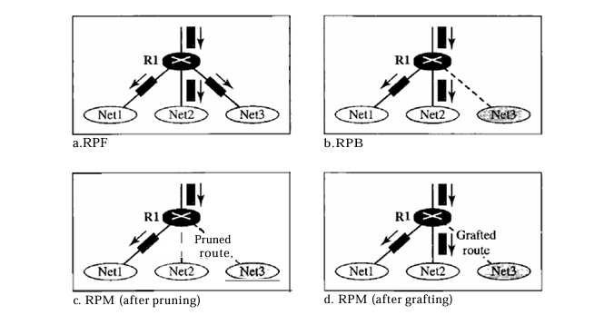
Reverse Path Multicasting (RPM)
As you may have noticed, RPB does not multicast the packet, it broadcasts it. This is not efficient. To increase efficiency, the multicast packet must reach only those networks that have active members for that particular group. This is called reverse path multicasting (RPM). To convert broadcasting to multicasting, the protocol uses two procedures, pruning and graft ing. Figure 22.43 shows the idea ofpruning and grafting.
RPF, RPB & RPM

Slide 81
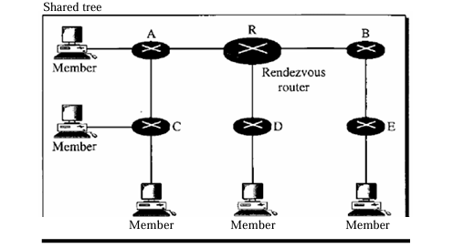
Core Based Tree (CBT) Protocol
The Core-Based Tree (CBT) protocol is a group-shared protocol that uses a core as the root of the tree. The autonomous system is divided into regions, and a core (center router or rendezvous router) is chosen for each region.
Group shared tree with rendezvous router

Slide 82
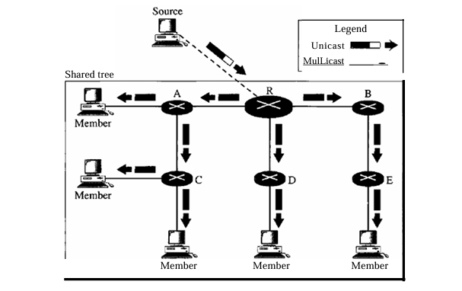
1. The source, which may or may not be part of the tree, encapsulates the multicast packet inside a unicast packet with the unicast destination address of the core and sends it to the core. This part of delivery is done using a unicast address; the only recipient is the core router.
2. The core decapsulates the unicast packet and forwards it to all interested interfaces.
3. Each router that receives the multicast packet, in turn, forwards it to all interested interfaces.

Slide 83
PIM (Protocol Independent Multicasting)

Slide 84
PIM (Protocol Independent Multicasting)
PIM-DM uses RPF and pruning and grafting strategies to handle multicasting. However, itis independent of the underlying unicast protocol
PIM-DM is used in a dense multicast environment, such as a LAN.
PIM-SM is similar to CRT but uses a simpler procedure. It is simpler because it does not require acknowledgment from a join message.
PIM-SM is used in a sparse multicast environment such as a WAN.
It creates a backup set of RPs (Rendezvous Point) for each region to cover RP failures.

Slide 85
MBONE

Slide 86
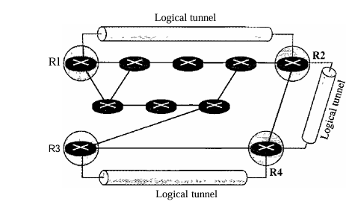
MBONE
Multimedia and real-time communication have increased the need for multicasting in the Internet. However, only a small fraction of Internet routers are multicast routers. In other words, a multicast router may not find another multicast router in the neighbor hood to forward the multicast packet.
They may not be connected directly but they are connected logically.
A logical tunnel is established by encapsulating the multicast packet inside a unicast packet. The multicast packet becomes the payload (data) of the unicast packet. The intermediate (non multicast) routers forward the packet as unicast routers and deliver the packet from one island to another. It's as if the unicast routers do not exist and the two multicast routers are neighbors.

Slide 87
THANK YOU

